Slide 1
What Is Social Responsibility?
The Classical View
Management’s only social responsibility is to maximize profits (create a financial return) by operating the business in the best interests of the stockholders (owners of the corporation).
Expending the firm’s resources on doing “social good” unjustifiably increases costs that lower profits to the owners and raises prices to consumers.

Slide 2
What Is Social Responsibility? (cont’d)
The Socioeconomic View
Management’s social responsibility goes beyond making profits to include protecting and improving society’s welfare.
Corporations are not independent entities responsible only to stockholders.
Firms have a moral responsibility to larger society to become involved in social, legal, and political issues.
“To do the right thing”

Slide 3
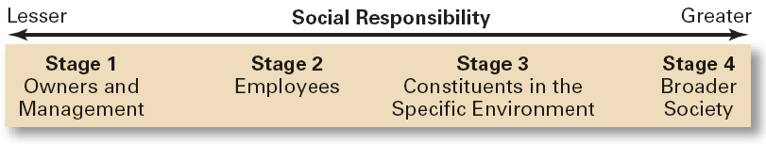
Exhibit 5–1 To Whom is Management Responsible?

Slide 4
Exhibit 5–2 Arguments For and Against Social Responsibility
For
Public expectations
Long-run profits
Ethical obligation
Public image
Better environment
Discouragement of further governmental regulation
Balance of responsibility and power
Stockholder interests
Possession of resources
Superiority of prevention over cure
Against
Violation of profit maximization
Dilution of purpose
Costs
Too much power
Lack of skills
Lack of accountability

Slide 5
From Obligation to Responsiveness to Responsibility
Social Obligation
The obligation of a business to meet its economic and legal responsibilities and nothing more.
Social Responsiveness
When a firm engages in social actions in response to some popular social need.
Social Responsibility
A business’s intention, beyond its legal and economic obligations, to do the right things and act in ways that are good for society.

Slide 6
Does Social Responsibility Pay?
Studies appear to show a positive relationship between social involvement and the economic performance of firms.
Difficulties in defining and measuring “social responsibility” and “economic performance raise issues of validity and causation in the studies.
Mutual funds using social screening in investment decisions slightly outperformed other mutual funds.
A general conclusion is that a firm’s social actions do not harm its long-term performance.

Slide 7
The Greening of Management
The recognition of the close link between an organization’s decision and activities and its impact on the natural environment.
Global environmental problems facing managers:
Air, water, and soil pollution from toxic wastes
Global warming from greenhouse gas emissions
Natural resource depletion

Slide 8
How Organizations Go Green
Legal (or Light Green) Approach
Firms simply do what is legally required by obeying laws, rules, and regulations willingly and without legal challenge.
Market Approach
Firms respond to the preferences of their customers for environmentally friendly products.
Stakeholder Approach
Firms work to meet the environmental demands of multiple stakeholders—employees, suppliers, and the community.
Activist Approach
Firms look for ways to respect and preserve environment and be actively socially responsible.

Slide 9
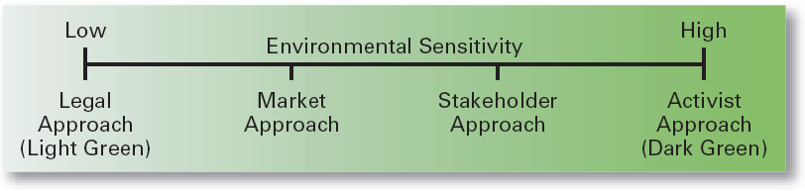
Exhibit 5–5 Approaches to Being Green
Source: Based on R.E. Freeman. J. Pierce, and R. Dodd. Shades of Green: Business Ethics and the Environment (New York: Oxford University Press, 1995).

Slide 10
Managerial Ethics
Ethics Defined
Principles, values, and beliefs that define what is right and wrong behavior.

Slide 11
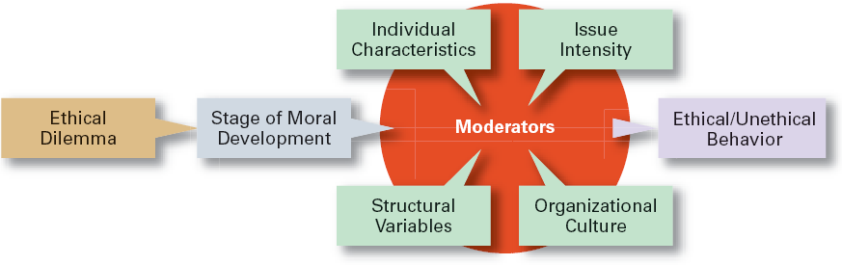
Exhibit 5–8 Factors That Affect Ethical and Unethical Behavior

Slide 12
Factors That Affect Employee Ethics
Moral Development
A measure of independence from outside influences
Levels of Individual Moral Development
Preconventional level
Conventional level
Principled level
Stage of moral development interacts with:
Individual characteristics
The organization’s structural design
The organization’s culture
The intensity of the ethical issue

Slide 13
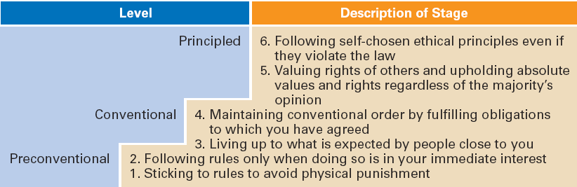
Exhibit 5–9 Stages of Moral Development
Source: Based on L. Kohlberg, “Moral Stages and Moralization: The Cognitive-Development Approach,” in T. Lickona (ed.). Moral Development and Behavior: Theory, Research, and Social Issues (New York: Holt, Rinehart & Winston, 1976), pp. 34–35.

Slide 14
Factors That Affect Employee Ethics (cont’d)
Moral Development
Research Conclusions:
People proceed through the stages of moral development sequentially.
There is no guarantee of continued moral development.
Most adults are in Stage 4 (“good corporate citizen”).

Slide 15
Individual Characteristics Affecting Ethical Behaviors
Values
Basic convictions about what is right or wrong on a broad range of issues

Slide 16
Individual Characteristics
Personality Variables
Ego strength
A personality measure of the strength of a person’s convictions
Locus of Control
A personality attribute that measures the degree to which people believe they control their own life.
Internal locus: the belief that you control your destiny.
External locus: the belief that what happens to you is due to luck or chance.

Slide 17
Other Variables
Structural Variables
Organizational characteristics and mechanisms that guide and influence individual ethics:
Performance appraisal systems
Reward allocation systems
Behaviors (ethical) of managers
An Organization’s Culture
Intensity of the Ethical Issue

Slide 18
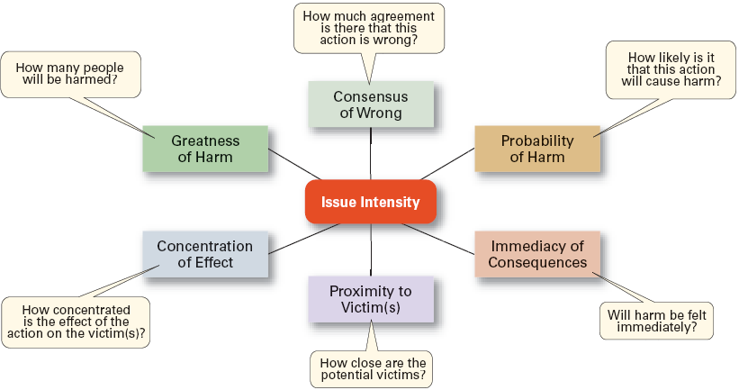
Exhibit 5–10 Determinants of Issue Intensity

Slide 19
Ethics in an International Context
Ethical standards are not universal.
Social and cultural differences determine acceptable behaviors.
Foreign Corrupt Practices Act
Makes it illegal to corrupt a foreign official yet “token” payments to officials are permissible when doing so is an accepted practice in that country.
The Global Compact

Slide 20
How Managers Can Improve Ethical Behavior in An Organization
Hire individuals with high ethical standards.
Establish codes of ethics and decision rules.
Lead by example.
Set realistic job goals and include ethics in performance appraisals.
Provide ethics training.
Conduct independent social audits.
Provide support for individuals facing ethical dilemmas.

Slide 21
The Value of Ethics Training
Can make a difference in ethical behaviors.
Increases employee awareness of ethical issues in business decisions.
Clarifies and reinforces the organization’s standards of conduct.
Helps employees become more confident that they will have the organization’s support when taking unpopular but ethically correct stances.

Slide 22
Exhibit 5–13 Twelve Questions for Examining the Ethics of a Business Decision
Have you defined the problem accurately?
How would you define the problem if you stood on the other side of the fence?
How did this situation occur in the first place?
To whom and to what do you give your loyalty as a person and as a member of the corporation?
What is your intention in making this decision?
How does this intention compare with the probable results?
Whom could your decision or action injure?
Can you discuss the problem with the affected parties before you make the decision?
Are you confident that your position will be as valid over a long period of time as it seems now?
Could you disclose without qualm your decision or action to your boss, your chief executive officer, the board of directors, your family, society as a whole?
What is the symbolic potential of your action if understood? If misunderstood?
Under what conditions would you allow exceptions to your stand?
Source: Reprinted by permission of Harvard Business Review. An exhibit from “Ethics Without the Sermon,” by L. L. Nash. November–December 1981, p. 81. Copyright © 1981 by the President and Fellows of Harvard College. All rights reserved.

Slide 23
Effective Use of a Code of Ethics
Develop a code of ethics as a guide in handling ethical dilemmas in decision making.
Communicate the code regularly to all employees.
Have all levels of management continually reaffirm the importance of the ethics code and the organization’s commitment to the code.
Publicly reprimand and consistently discipline those who break the code.

Slide 24
Ethical Leadership
Managers must provide a good role model by:
Being ethical and honest at all times.
Telling the truth; don’t hide or manipulate information.
Admitting failure and not trying to cover it up.
Communicating shared ethical values to employees through symbols, stories, and slogans.
Rewarding employees who behave ethically and punish those who do not.
Protecting employees (whistleblowers) who bring to light unethical behaviors or raise ethical issues.

Slide 25
Managing Ethical Lapses and Social Irresponsibility
Provide ethical leadership
Protect employees who raise ethical issues (whistle-blowers)

Slide 26
Terms to Know
classical view
socioeconomic view
social obligation
social responsiveness
social responsibility
social screening
greening of management
values-based management
ethics
values
ego strength
locus of control
code of ethics
whistle-blower
social entrepreneur
social impact management

